Slide 1
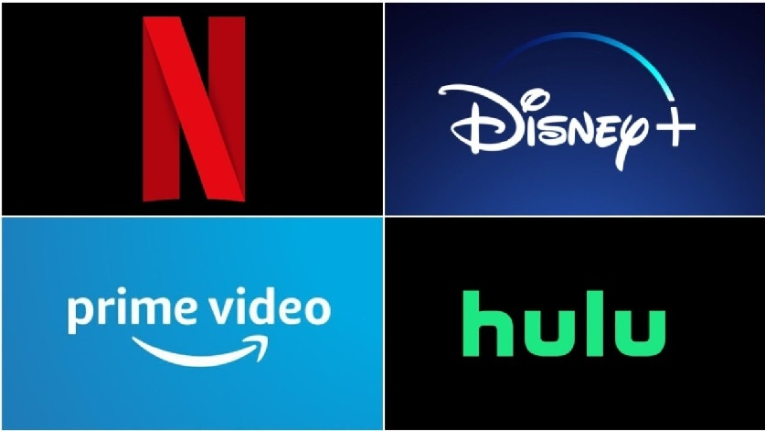
MOVIES ON NETFLIX , PRIME VIDEO , DISNEY AND HULU CASE STUDY
A RESEARCH PROJECT BY KARAN KATYAL

Slide 2
CONTENTS
Case study
Objectives
Important Factors
Table Analysis
TV Shows Analysis
Inferences
Conclusions

Slide 3
CASE Study
This case study consists of 2 dataset.
The first dataset consists of movies and TV shows available on the OTT platforms( Netflix, Prime Video , Hulu, Disney+) including with their information such in which year the movies was produced , IMDB ratings and much more things.
The second dataset consists of genre of the TV shows and movies

Slide 4
Objectives
To find out the best service provided by the online streaming platform as in the recent years , number of online streaming platforms has increased a lot . Like Netflix , Disney + , Hulu ,Prime video and many more ......what if I don't want to pay for all of them at the same time . In order to do the findings , I have taken this dataset to answer these questions.

Slide 5
Important Factors
Biggest number of movies and TV shows
More recent TV shows and movies
Better suited for children or adults
The best for old movies and TV shows
Best IMDB ratings

Slide 6
Table analysis
This dataset consist of two tables.
This dataset is an amalgamation of :
the data that was scraped , which comprised a comprehensive list of movies available on various streaming platforms
Genre dataset

Slide 7
Tv shows analysis

Slide 8
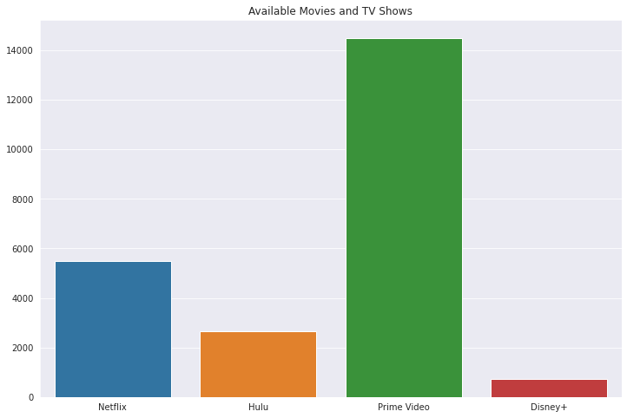
Biggest number of movies and TV shows

Slide 9
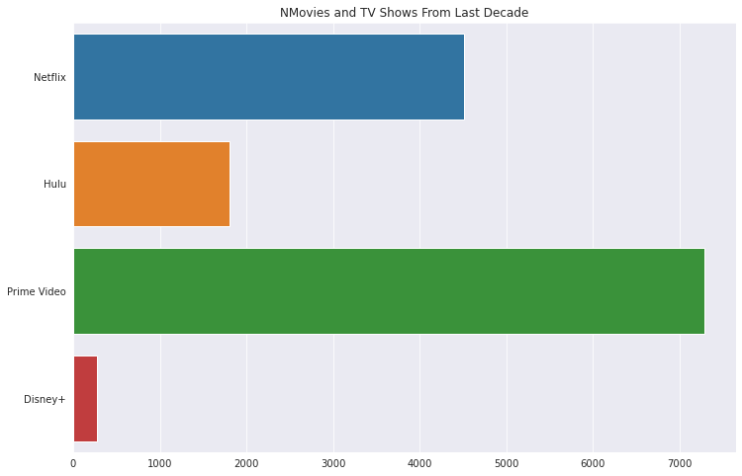
More recent TV shows and movies

Slide 10
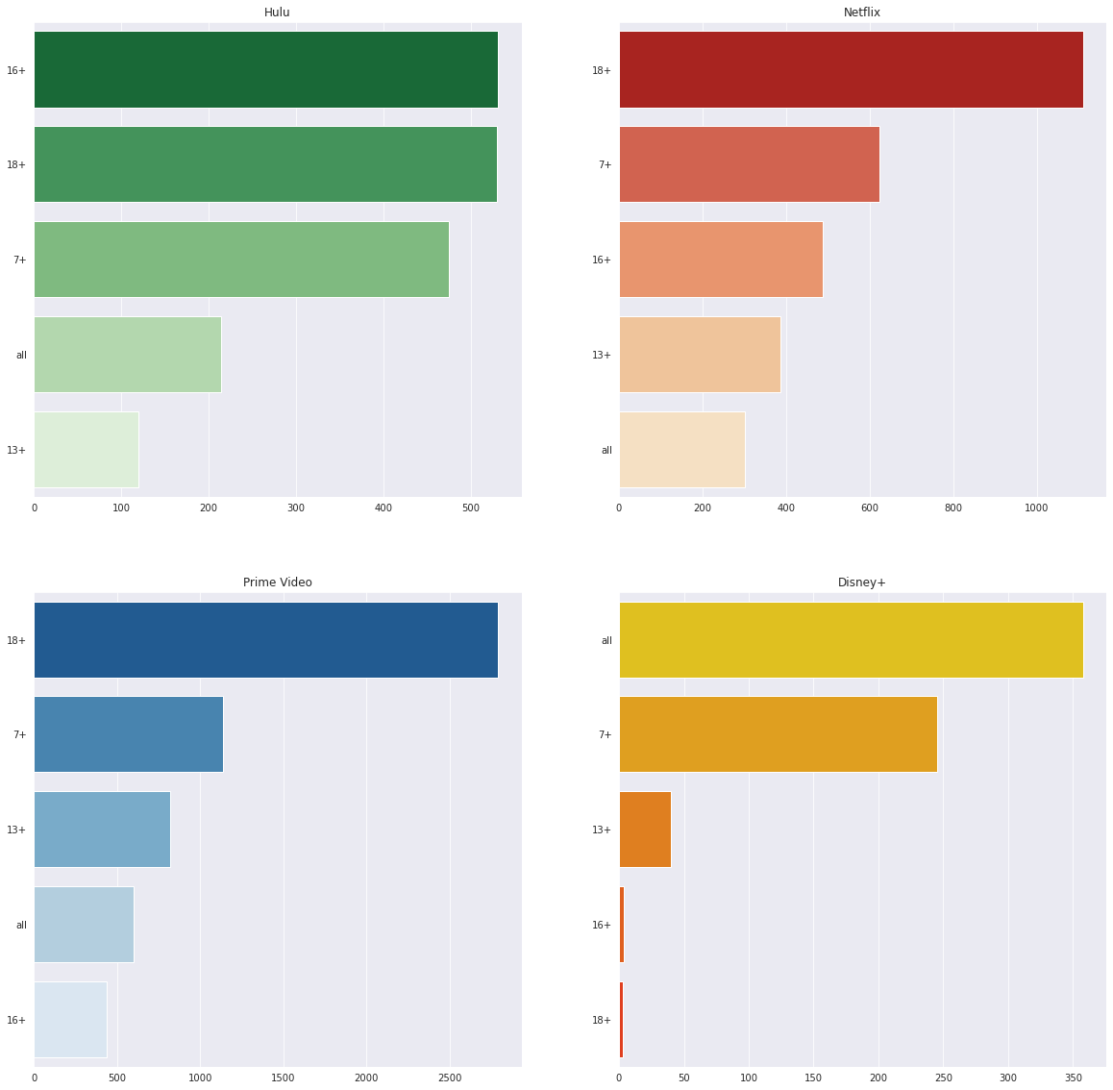
Better suited for children or adults
Hulu , Netflix and Prime video is better suited for children who are 18+
While Disney + is better for all kind of age groups

Slide 11
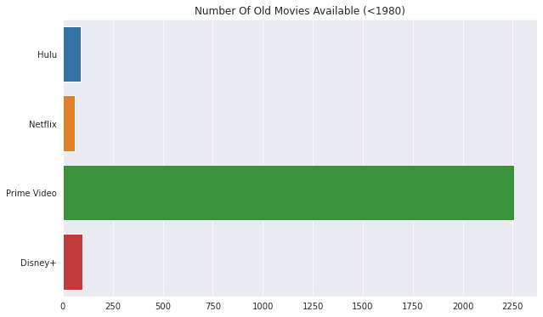
The best for old movies and TV shows

Slide 12
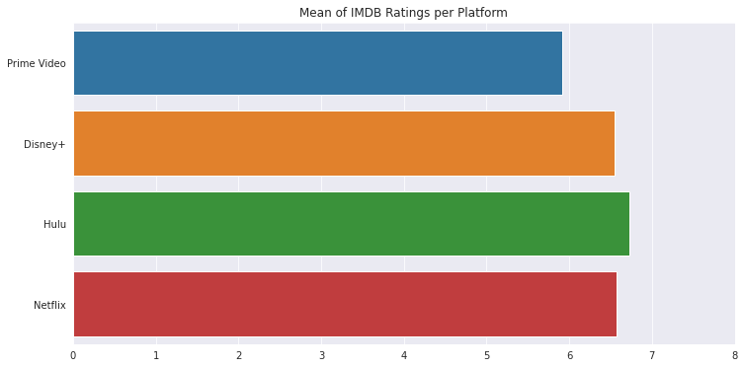
mean of IMDB ratings

Slide 13
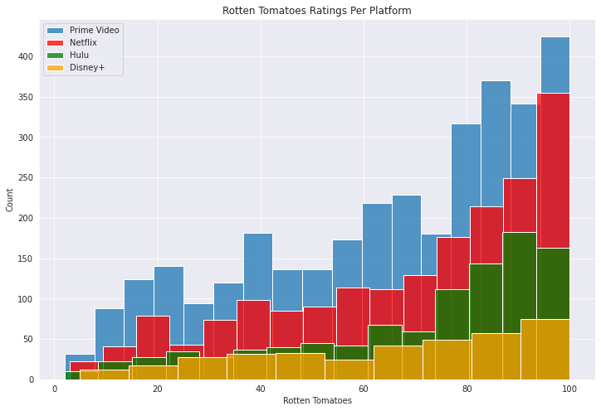
Rotten tomatoes ratings

Slide 14
Joining two tables
In order to get the best results from a dataset and to find the conclusion we have to join the two or more tables in a database.
So in this dataset we have joining the “GENRE” table with the “Tvshows” table

Slide 15
Inferences
Quantity of Movies: Prime Video is by far the service with more movies and tv shows, followed by Netflix. Netflix, Hulu and Disney+ together still don't reach half the quantity of movies available on Prime Video.
Recent Titles: Prime Video is also the catalog with the biggest quantity of recent movies (10 years old or less). But this represents only 50% of its catalog. On the other hand, Netflix and Hulu have a much bigger percentage of their catalogs composed by recent movies - 82% and 67% respectively. And Disney+ has surprisingly only 36%! Which means their movie catalog is currently mostly of classics.
Age: Adult movies (18+) is the biggest part of the Netflix, Prime Video and Hulu catalogs, although they also offer a good quantity of movies for children and teenagers. Disney+, focuses primarily on movies for the whole family and children. It is safe to say that more than 90% of its catalog can be watched by children.
Old Movies: Prime Video has really focused on the classics! That helps to explains why it has such a huge catalog when compared to the other services. About 2K of the total catalog is from movies prior to 1980.
Movie Ratings: Hulu has the best mean ratings for both IMDB and Rotten Tomatoes. All platforms offer a good quantity of well rated movies in their catalog. However, the Prime Video ratings mean is much lower compared to the other platforms. We can conclude that the overall quality os the Hulu and Netflix catalogs are much better. Having more movies and series does not mean having the best catalog.

Slide 16
Conclusions:
If you are interested on having a huge catalog Prime Video is definitely a good choice. Netflix comes second and is also a good choice - both have a big catalog!
For watching recent movies and tv shows (last decade), Netflix is a great option - those compose 81% of its catalog. Hulu also has a good percentage of 67%.
If you are interested in movies for Adults, and genres such as Dramas, Comedies and Thriller, Netflix , Hulu and Prime Video are all good options.
Disney+ is defintely a great choice for family friendly movies and genres such as fantasy and adventure.
Prime Video seems to be the best platform for watching very old movies (40 years old or more) since it offers about 2K movies prior to 1980.
Hulu has a smaller catalog, but it comes first on the ratings mean. If you are interested in having a small catalog with good quality stuff, Hulu may be the best choice. Disney+ also has a small catalog while keeping a good overall quality. Its catalog should increase during the next years since it is a new service. Netflix is a good middle term between having a big catalog x quality. Prime Video comes last on ratings, a consequence of having such a huge catalog.

Slide 17
Thank you

